Slide 1
test cases
Defect List screen

Slide 2
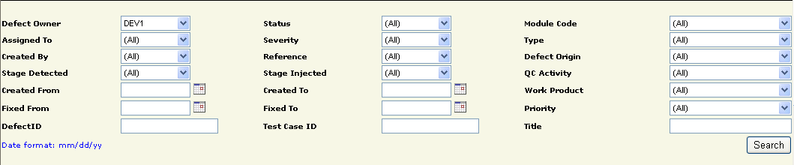
search error
almost no errors

Slide 3

looking forward to upgrading
more choices

Slide 4
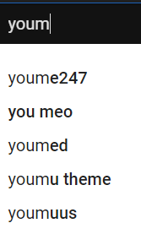
show the most similar requests

Slide 5
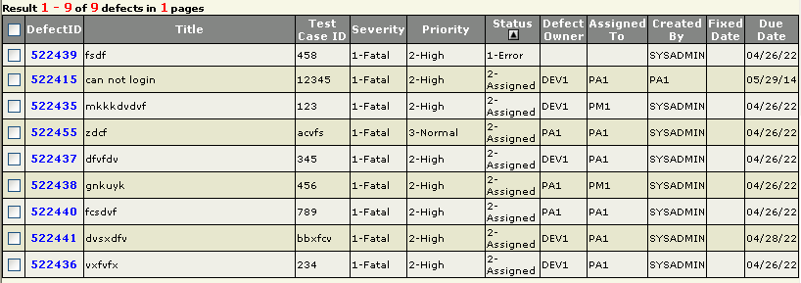
side defects List defects
error checks and sorting error
can sort without dropping checked cells

Slide 6
Can't arrange multiple content at the same time
select can sort a lot of content

